Slide 1

CoolTShirt Marketing
Campaign Analysis
Learn SQL from Scratch
Katherine Ottinger
December 10, 2018

Slide 2
Table of Contents
Gaining familiarity with CoolTShirts
Determining the user journey
Optimizing the future campaign budget

Slide 3
1. Gaining Familiarity with CoolTShirts

Slide 4
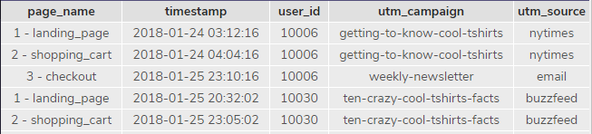
1.1 Database Schema
CoolTShirts has one table named page_visits. This table has 5,692 rows and contains 5 columns:
page_name (text)
timestamp (text)
user_id (integer)
utm_campaign (text)
utm_source (text)
5 rows of data are shown below to get an understanding of the data in the table. These rows of data were generated with the query to the right.
SELECT *
FROM page_visits
LIMIT 5;

Slide 5
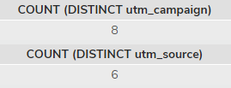
1.2 Campaigns and Sources
CoolTShirts has run several campaigns recently and receives users from several sources. UTM parameters are used to track how and when users reach a site. The two queries to the right were used to determine the information below:
CoolTShirts has 8 unique campaigns – these can be found in the utm_campaign column. utm_campaign are the ads run by CoolTShirt on a variety of websites or other internet access locations (email.) User visits are attributed to the campaign if they arrive at the site due to a specific campaign.
CoolTShirts has 6 unique sources – these can be found in the utm_source column. utm_source lists the website or internet access location where the ad was clicked.
SELECT COUNT (DISTINCT utm_campaign)
FROM page_visits;
SELECT COUNT (DISTINCT utm_source)
FROM page_visits;

Slide 6
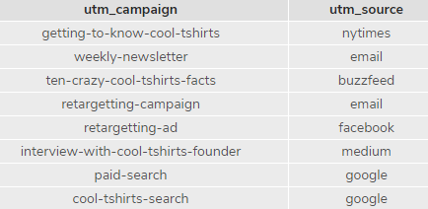
1.3 Campaigns and Sources Continued
CoolTShirts campaigns (ads) and sources (locations where the ads were clicked) are related. Sometimes, different ads (utm_campaign) are found on the same locations (utm_source):
Websites (utm_source) like Google have multiple utm_campaign ads that are visible such as “paid-search” and “cool-tshirts-search”
Some utm_source locations only have one utm_campaign available, like the utm_source buzzfeed only has the utm_campaign “ten-crazy-cool-tshirts-facts”
SELECT DISTINCT utm_campaign, utm_source
FROM page_visits;

Slide 7
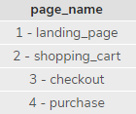
1.4 CoolTShirt Pages
CoolTShirts has several pages on the website that users can interact with during their visit to the site:
The query on the right is how the list of unique page_name options below was generated
Only users who have made a purchase will reach the “4 – purchase” page
SELECT DISTINCT page_name
FROM page_visits;

Slide 8
2. The User Journey

Slide 9
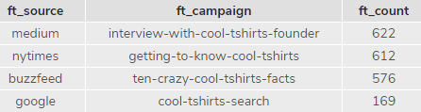
2.1 Campaign First Touches
Determining first touches is a good way to see how effective a specific advertising campaign has been in the past in getting users to discover a website. The query to the right shows the most successful to the least successful campaigns (utm_campaign) at generating first touches for CoolTShirts
The “interview-with-cool-tshirts-founder” campaign has been the most successful ad in driving first touches – this was through the medium source
The “cool-tshirts-search” has been the least successful campaign that resulted in any first touches – this was through the google source
Of the eight campaigns run by CoolTShirts, only 4 have resulted in first touches
WITH first_touch AS (
SELECT user_id,
MIN(timestamp) as first_touch_at
FROM page_visits
GROUP BY user_id),
ft_attr AS (
SELECT ft.user_id,
ft.first_touch_at,
pv.utm_source,
pv.utm_campaign
FROM first_touch ft
JOIN page_visits pv
ON ft.user_id = pv.user_id
AND ft.first_touch_at = pv.timestamp
)
SELECT ft_attr.utm_source as 'ft_source',
ft_attr.utm_campaign as 'ft_campaign',
COUNT(*) as 'ft_count'
FROM ft_attr
GROUP BY 1, 2
ORDER BY 3 DESC;

Slide 10
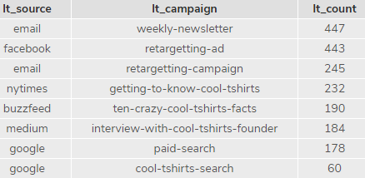
2.2 Campaign Last Touches
Determining last touches is a good way to see how effective a specific advertising campaign has been in getting a user to return or be drawn back to the CoolTShirts website. The query to the right shows the most successful to the least successful campaigns (utm_campaign) at generating first touches for CoolTShirts
The “weekly-newsletter” campaign has been the most successful ad in driving lasttouches – this was done via email
The “cool-tshirts-search” has been the least successful campaign that resulted in any last touches – this was via the google source
WITH last_touch as (
SELECT user_id,
Max(timestamp) as last_touch_at
FROM page_visits
GROUP BY user_id),
lt_attr AS (
SELECT lt.user_id,
lt.last_touch_at,
pv.utm_source,
pv.utm_campaign,
pv.page_name
FROM last_touch lt
JOIN page_visits pv
ON lt.user_id = pv.user_id
AND lt.last_touch_at = pv.timestamp
)
SELECT lt_attr.utm_source as 'lt_source',
lt_attr.utm_campaign as 'lt_campaign',
COUNT(*) as 'lt_count'
FROM lt_attr
GROUP BY 1, 2
ORDER BY 3 DESC;

Slide 11
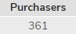
2.3 User Purchases
CoolTShirts ad campaigns have resulted in 361 unique users making a purchase
The query to the right shows how this total was determined
SELECT COUNT (DISTINCT user_id) as 'Purchasers'
FROM page_visits
WHERE page_name = '4 - purchase';

Slide 12
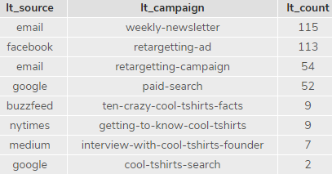
2.4 Campaign Last Touches Leading to Purchases
The campaigns with last touches most successful at leading to a purchase are listed below. The query to determine this is to the right.
The “weekly-newsletter” campaign was most successful at resulting in a purchase from a user
The “retargeting-ad” campaign was almost as successful as the “weekly newsletter” in securing a purchase from a user
The “cool-tshirts-search” campaign was least successful at resulting in a purchase
WITH last_touch as (
SELECT user_id,
Max(timestamp) as last_touch_at
FROM page_visits
where page_name= '4 - purchase'
GROUP BY user_id),
lt_attr AS (
SELECT lt.user_id,
lt.last_touch_at,
pv.utm_source,
pv.utm_campaign,
pv.page_name
FROM last_touch lt
JOIN page_visits pv
ON lt.user_id = pv.user_id
AND lt.last_touch_at = pv.timestamp
)
SELECT lt_attr.utm_source as 'lt_source',
lt_attr.utm_campaign as 'lt_campaign',
COUNT(*) as 'lt_count'
FROM lt_attr
GROUP BY 1, 2
ORDER BY 3 DESC;

Slide 13
2.5 Typical User Journey
The information below is a general review of a typical user journey to get to the CoolTShirts website and to the purchases page.
Most users first arrive at the CoolTShirts website from medium via the “interview-with-cool-tshirts-founder” campaign (622 users) or from nytimes via the “getting-to-know-cool-tshirts” campaign (612 users)
However, those two campaigns are not the most successful at securing a purchase from a user
Of the 361 unique users that made a purchase only 1.9% came from the “interview-with-cool-tshirts-founder” campaign and 2.5% came from the “getting-to-know-cool-tshirts” campaign
The most successful last touch campaigns were the “weekly-newsletter” via email and the “retargeting-ad” from facebook

Slide 14
3. Optimizing the CoolTShirts Campaign Budget

Slide 15
3.1 Determining the Best use of the CoolTShirts Campaign Budget: Background
The CoolTShirts Campaign budget has a limited amount of money that needs to be invested as wisely as possible based on the information available. Only 5 campaigns can be recommended for future investment based on the information below.
There needs to be a balance between attracting first touches and redirecting users back to the site for a last touch that leads to a purchase since not all campaigns are first touches (ex. email campaigns will not work as a first touch because CoolTShirts does not yet have the user email – this would occur during a first touch)
Spreading the word with informative articles like the Interview with the CoolTShirts founder and Getting to Know CoolTShirts seems to attract customers and encourage them to learn about the company in a positive way – these two campaigns account for 62.3% of all first touches
While those users are on the website they should be encouraged to sign up for the newsletter as that is the most successful way to convert a user to a purchaser – 46.8% of purchases have a last touch via email
Those users that did not sign up for the weekly newsletter should be shown the retargeting ad via Facebook – 31.3% of purchasers have a last touch with this campaign/source combination
Rather than including another email campaign (retargeting-campaign) the decision was made to include a different source of last touches with the goal of reaching a larger target audience to make a final purchase – the paid search results have the highest percentage of purchases made compared to the number of last touches of any campaign

Slide 16
3.2 Determining the Best use of the CoolTShirts Campaign Budget: 5 Recommended Campaigns
Campaign Type | Campaign Name | Notes
First Touch | interview-with-cool-tshirts-founder | Recommend choosing a similar site to Medium as the potential customer base has likely been saturated at Medium
 | getting-to-know-cool-tshirts | Recommend choosing a similar site to NY Times as the potential customer base has likely been saturated at NY Times
Last Touch | weekly-newsletter | This should continue to go to all customers with emails available to CoolTShirts as a customer may become a purchaser or repurchaser at any time
 | retargetting-ad | Since Facebook is user specific there should not be much overlap in customer base exposed to this ad
 | paid-search | While this does not have the third highest percentage of purchases (it’s fourth, behind the email retargeting-campaign) it does have the highest percent of users that make a purchase based on their last touch (29.2%) and email users are already receiving a last touch campaign. It would be best to add another source for last touch emails to reach the widest population possible.

Slide 17
Appendix

Slide 18
Additional Calculations
The additional calculations below show additional detail used to determine which campaigns should be recommended for the limited budget (top 5.) The cell in yellow shows the initial reason why each campaign was chosen. More details can be found on slides 3.1 and 3.2.
Campaign | Source | First Touches | % First Touches | Last Touches | % Last Touches | Purchases | % Purchases | First Touches / Purchases | Last Touches / Purchases
Weekly Newsletter | Email | - | - | 447 | 22.6% | 115 | 31.9% |  | 25.7%
Retargetting Ad | Facebook | - | - | 443 | 22.4% | 113 | 31.3% |  | 25.5%
Retargetting Campaign | Email | - | - | 245 | 12.4% | 54 | 15.0% |  | 22.0%
Getting to Know Cool Tshirts | NYTimes | 612 | 30.9% | 232 | 11.7% | 9 | 2.5% | 1.5% | 3.9%
Ten Crazy Cool Tshirt Facts | Buzzefeed | 576 | 29.1% | 190 | 9.6% | 9 | 2.5% | 1.6% | 4.7%
Interview with Cool Tshirts Founder | Medium | 622 | 31.4% | 184 | 9.3% | 7 | 1.9% | 1.1% | 3.8%
Paid Search | Google | - | - | 178 | 9.0% | 52 | 14.4% |  | 29.2%
Cool Tshirts Search | Google | 169 | 8.5% | 60 | 3.0% | 2 | 0.6% | 1.2% | 3.3%

